Slide 1
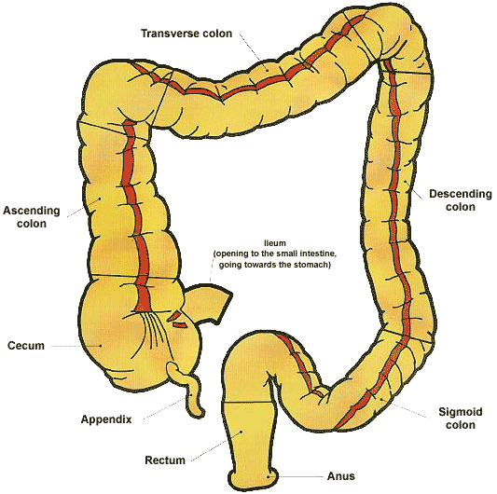
Colorectal Cancer
Risk Factors:
Age
Genetics
Cancer Screening | When to check
Fecal | At 50 y/o then Annually
Sigmoidoscopy | At 50 y/o then Q5 years
Colonoscopy | At 50 y/o then Q10 years

Slide 2
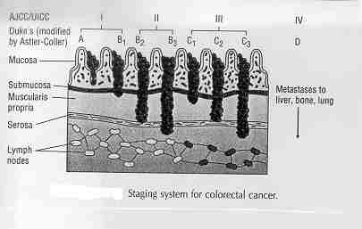
Staging Colorectal Cancer

Slide 3
Treatment of Colon Cancer
Stage I/IIA
Stage IIB/III
Stage IV: Metastases
Surgery
+
Lymph Node Dissection (LND)
Surgery
+
LND
+
Adjuvant Chemo
Surgery
+
LND
+
Palliative Chemo (to relieve pain)
Regimen | Adjuvant Chemo | Duration | Followup
FOLFOX regimen: | 5-FU + Leucovorin + Oxaliplatin | 6 months | Q3 months
 | Capecitabine + Oxaliplatin |  | Q3 months
 | Capecitabine | 6 months | Q3 months

Slide 4
Treating Metastatic Colorectal Cancer
FOLFOX or Capecitabine/OX +bevacizumab | 1st line
FOLFOX + panitumumab (KRAS WT only) | 1st line
FOLFIRI + bevacizumab | 2nd line (failed oxaliplatin)
FOLFIRI +/_ ziv-aflibercept | 2nd line (failed oxaliplatin)
FOLFIRI + (cetuximab or panitumumab) | 2nd line (KRAS WT only)
Irinotecan + (cetuximab or panitumumab) | 2nd line (KRAS WT only)
infusional 5 FU (less intensive regimens) | 2nd or 3rd line
Regorafenib | 3rd line

